Slide 1
Chapter 11 Objectives
Understand the function and composition of the lipid bilayer
Understand how the composition of a membrane influences it’s fluidity
Be able to describe different ways in which membrane proteins interact with and regulate the lipid bilayer

Slide 2
Chapter 11: Cell Membranes

Slide 3
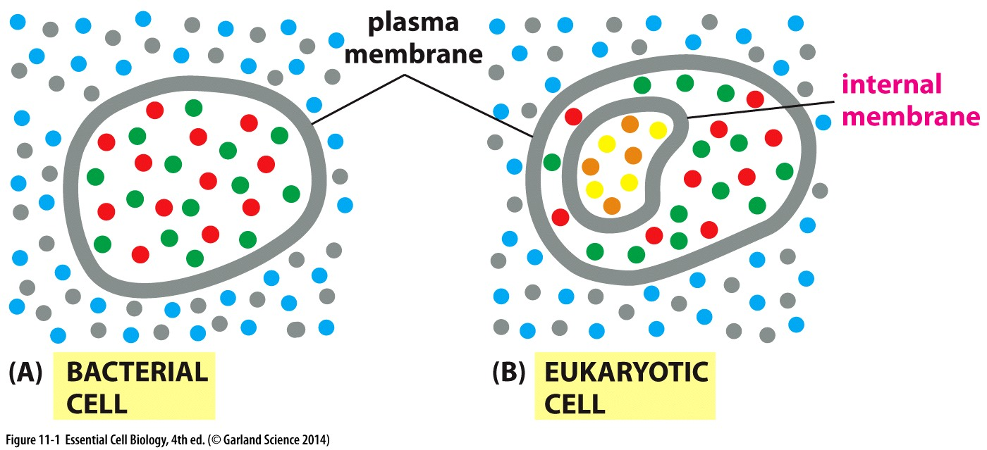
Cell membranes compartmentalize cells
The cytoplasm is separated from the external environment

Slide 4
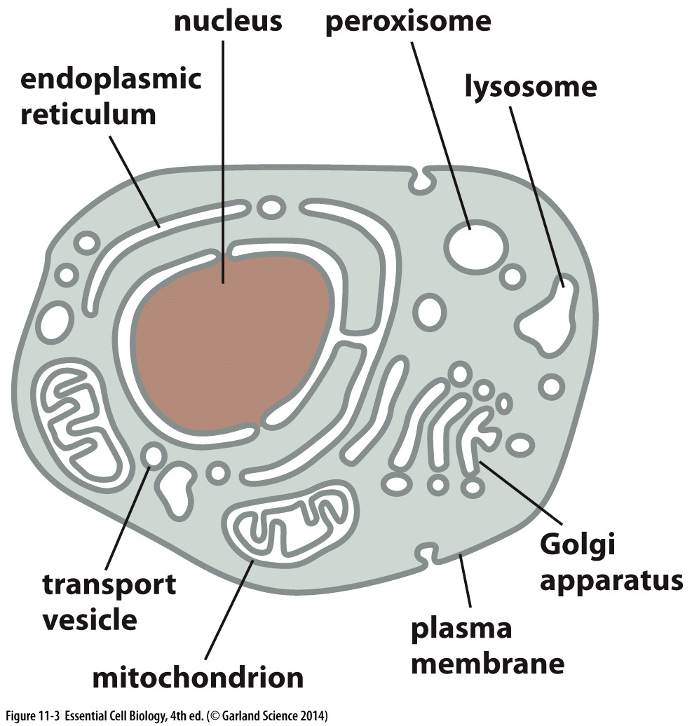
Cell membranes compartmentalize cells
Organelles are separated from the cytoplasm
Organelle membranes have some shared features, some distinct features
Allows for distinct environments within each membrane-contained compartment

Slide 5
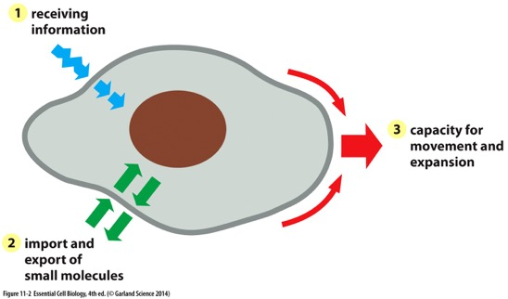
Multi functional plasma membrane
Plasma membrane:
~5nm thick
barrier between internal and external world
Nutrients in
Waste products out
In the membrane:
Receptor proteins receive signals from the environment
Transport proteins enable import and export of small molecules
Flexibility enables mobility

Slide 6
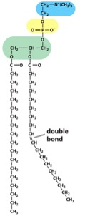
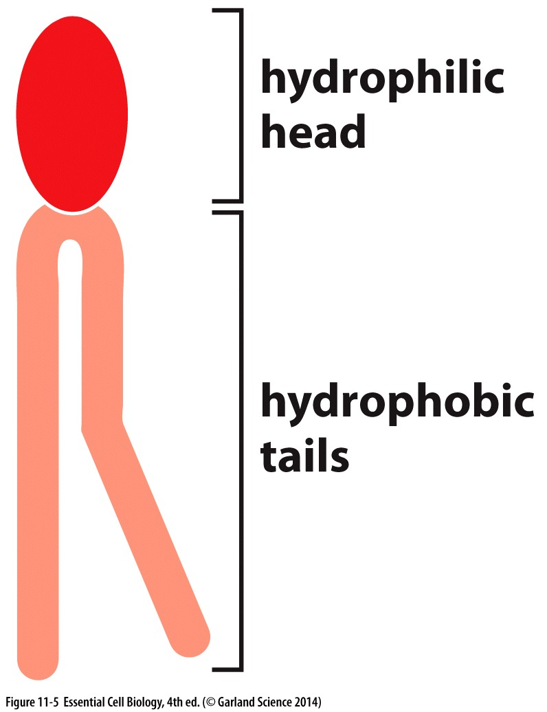
Lipids are the major constituent of membranes
Phospholipids are prevalent

Slide 7
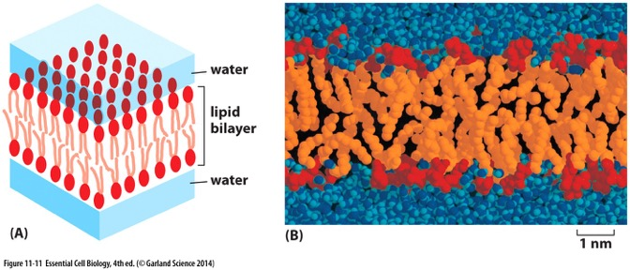
Membrane Lipids Form a Bilayer in aqueous solution
Hydrophobic tails packed together
Hydrophilic heads exposed to aqueous environment

Slide 8
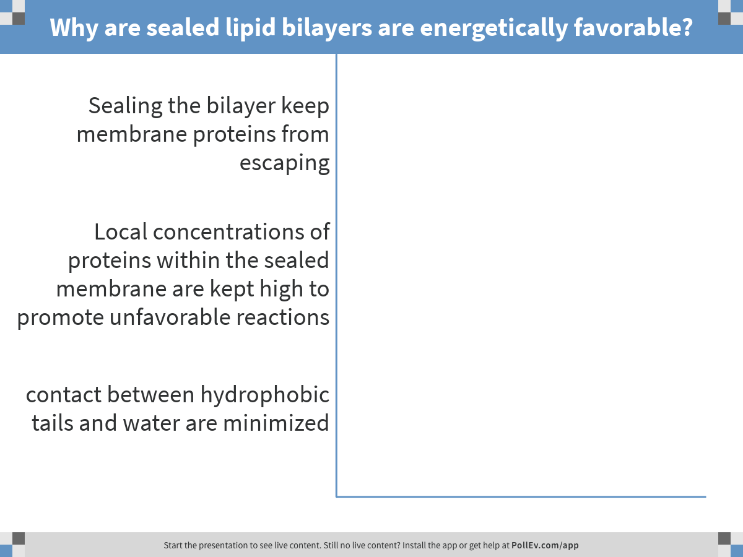
Notes:
Why are sealed lipid bilayers are energetically favorable?
https://www.polleverywhere.com/multiple_choice_polls/aRy6BXE078fJlLG

Slide 9
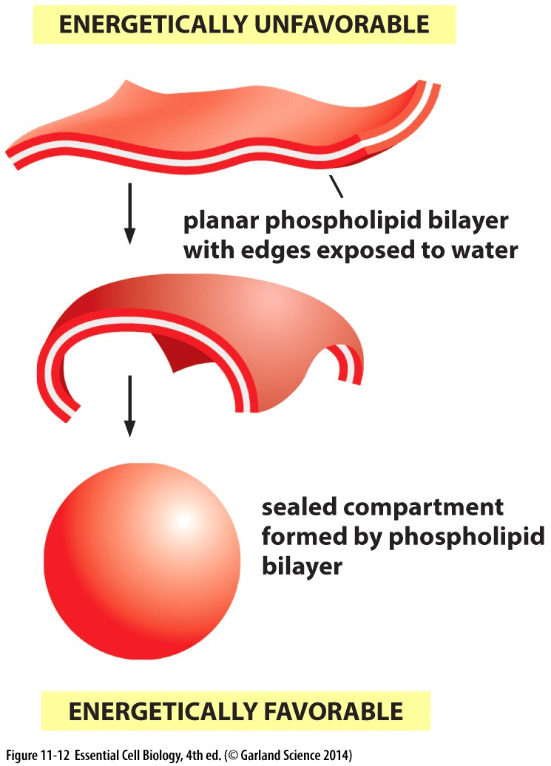
Sealed bilayers are energetically favorable
Minimize/prevent contact of hydrophobic tails with water

Slide 10
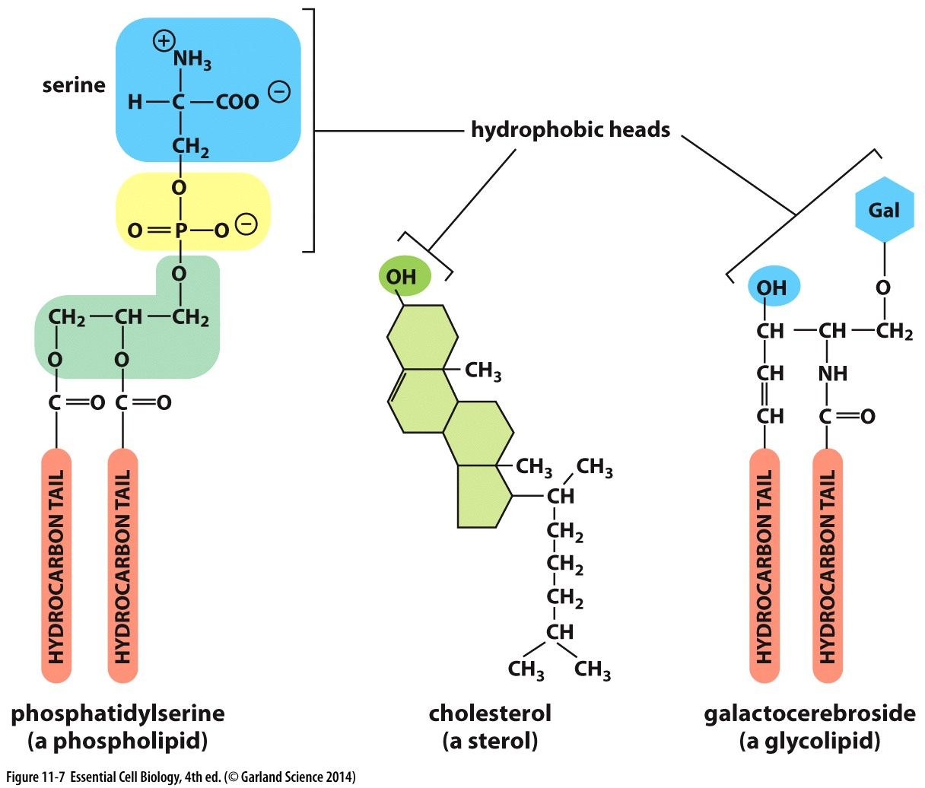
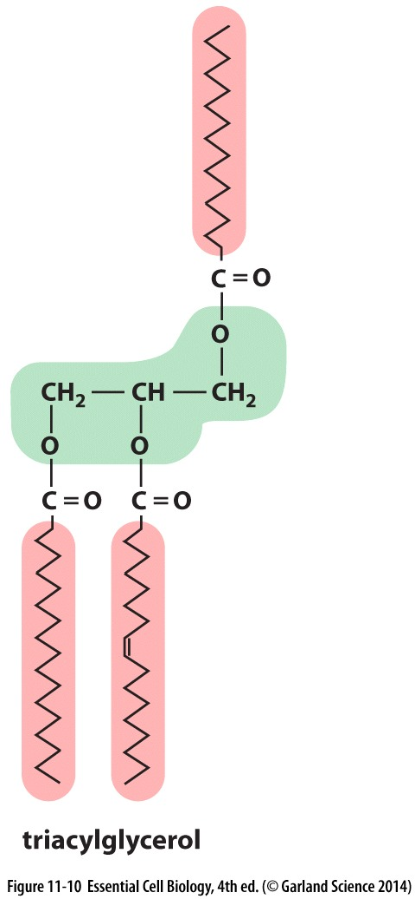
Lipids are the major constituent of membranes
Phospholipids are prevalent
Also other lipids: glycolipids and sterols (like cholesterol)
ERROR IN YOUR BOOK!
Fats are completely hydrophobic:
no charged head
Hydrophilic heads

Slide 11
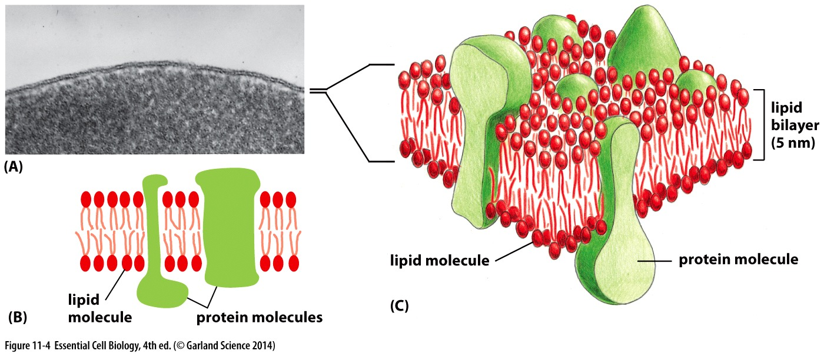
Protein molecules can insert in the membrane
Dependent on protein sequence and structure →
hydrophobic domains within the membrane
Hydrophilic domains on the surface/extending past the membrane

Slide 12
Properties of the Lipid Bilayer
a two dimensional fluid

Slide 13
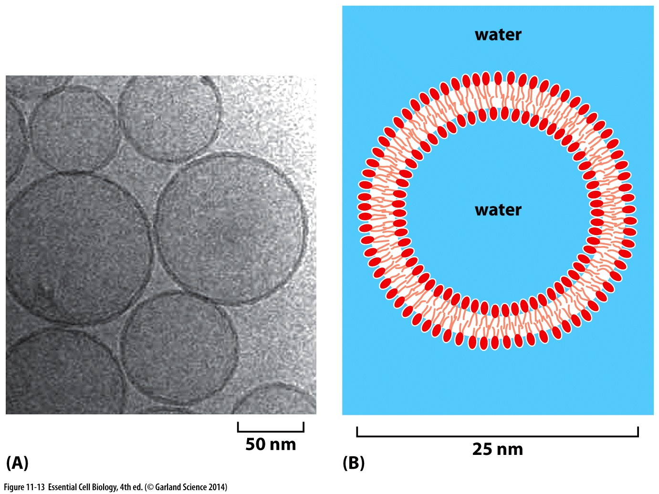
Lipid Bilayer: A flexible two-dimensional fluid
Lipids are not stagnant, move within the lipid bilayer
So do proteins integrated in the membrane.

Slide 14
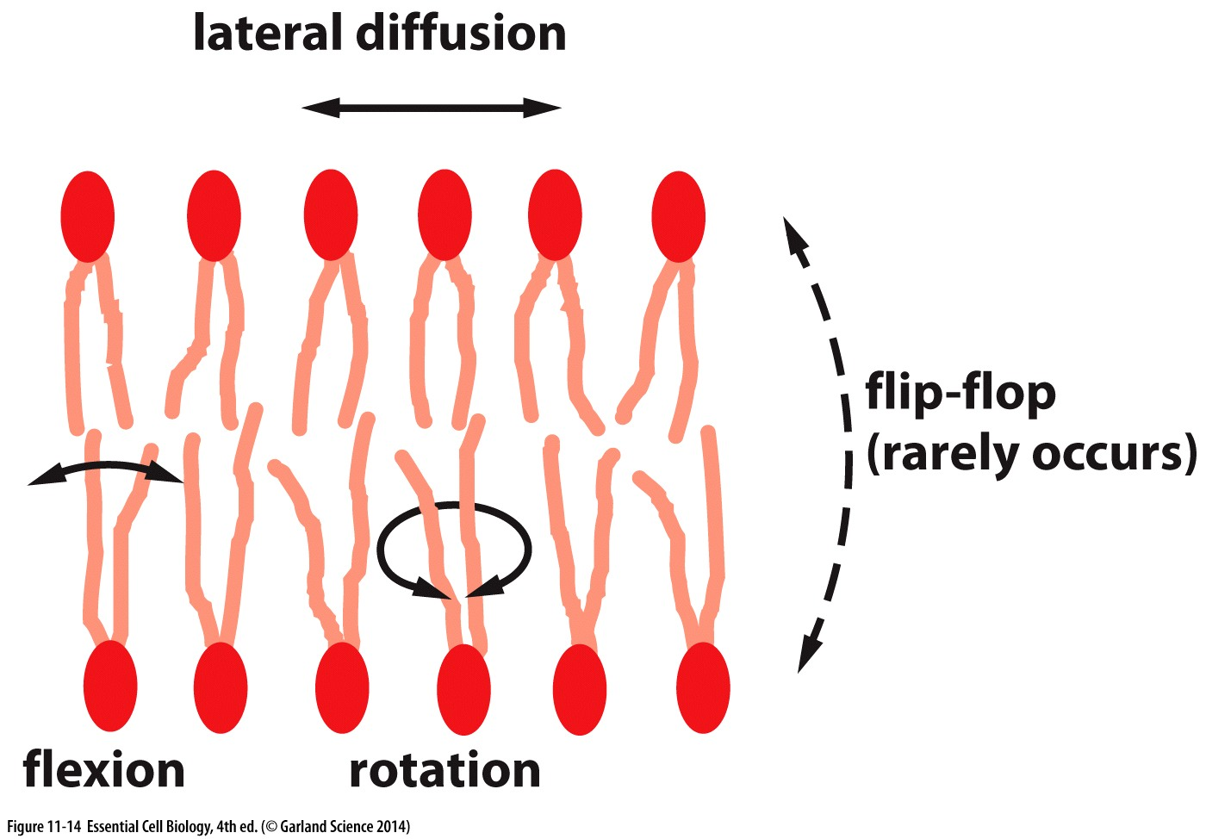
Dynamics within the membrane
Lipids themselves can move, rotate and flip (usually not without help)
Saturation of lipid polycarbon tails influences how tightly they pack
Saturated = more hydrocarbon interactions= more viscous, less fluid
Other components of the membrane also influence fluidity

Slide 15
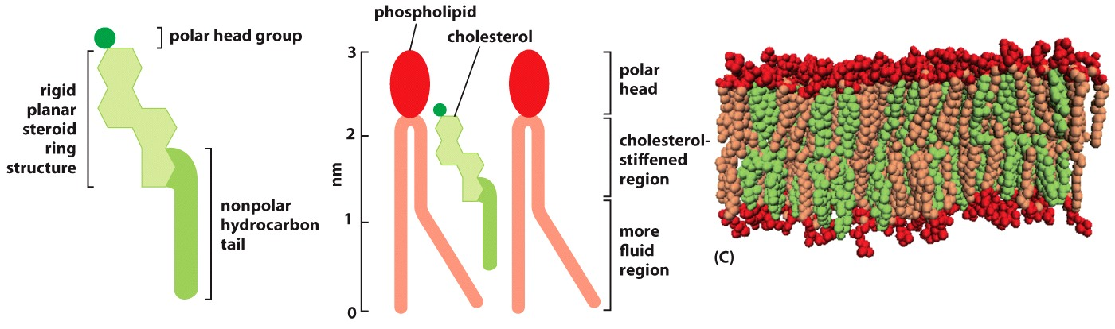
Rigid structures limit fluidity
Cholesterol molecules have rigid region
Membranes with high cholesterol will be less fluid → may impact function
Fluidity of a membrane is important for it’s function and must be maintained → active regulation

Slide 16
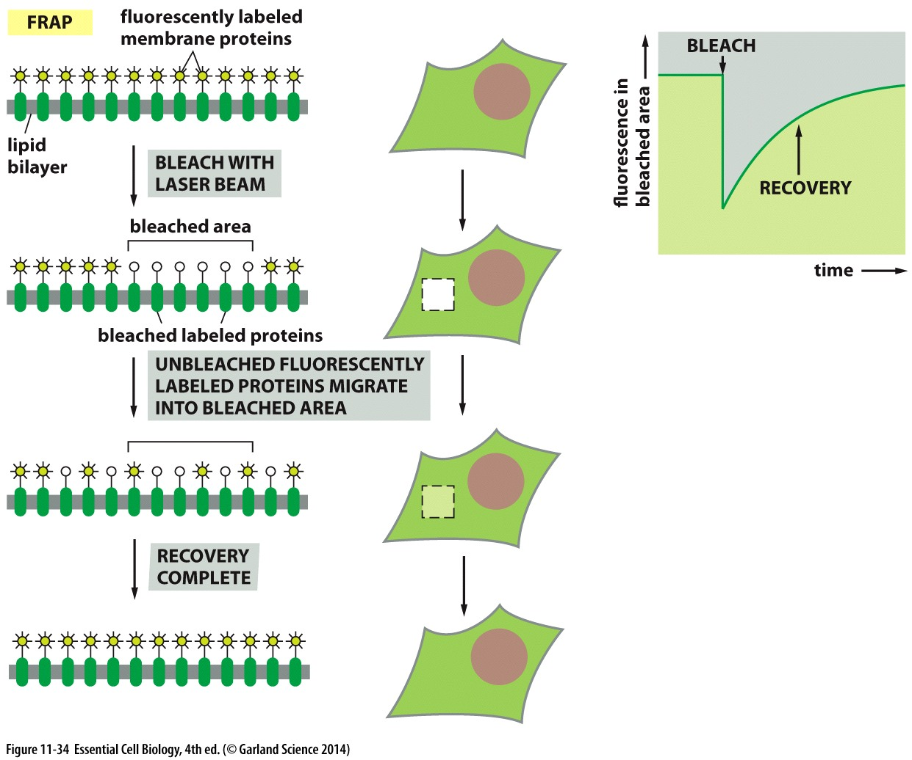
Lipids in the cell membrane are motile
Fluorescence Recovery After Photobleaching to experimentally examine the motility of lipids

Slide 17
Regulation of bilayer composition

Slide 18
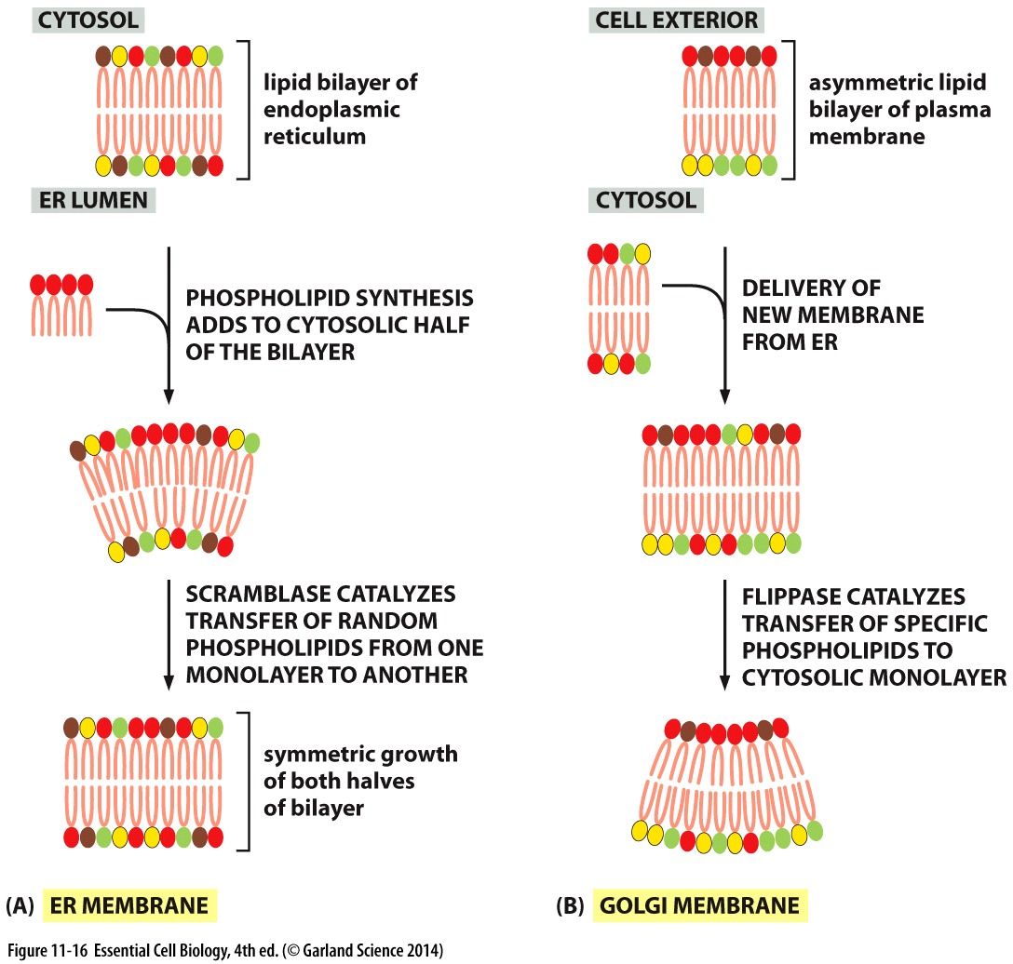
Symmetric composition
New phospholipids are:
Synthesized on the cytosolic surface of the endoplasmic reticulum
Inserted exclusively into the cytosolic side of the bilayer
Scramblases randomly choose phospholipids to move from one half of the bilayer to the other
ER Membranes are symmetric

Slide 19
Asymmetric composition
ER membrane pinches off to form vesicles
Vesicles fuse with other membranes
Composition of many of these membranes is asymmetric
Flippases:
Family of enzymes that selectively flip phospholipids
Membranes have a distinct inside and outside

Slide 20
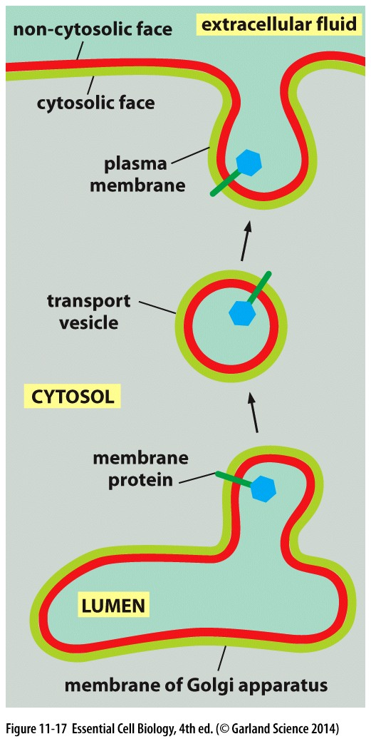
Asymmetry for function
Membranes retain their orientation during budding and delivery
Cytosol-facing membrane remains facing the cytosol
Sugar groups added to glycolipids in the golgi
No flippase exists for glycolipids so they stay on the inside/lumen
Glycolipids are exclusively found on the outside/non cytosolic side of the membrane
Forms a carbohydrate coat that protect the cell

Slide 21
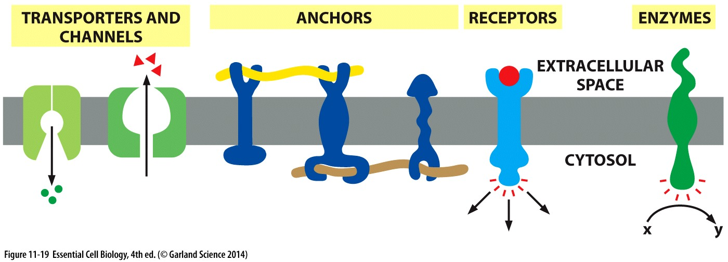
Knowing inside from out
Membrane orientation is essential for protein positioning and function

Slide 22
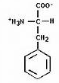
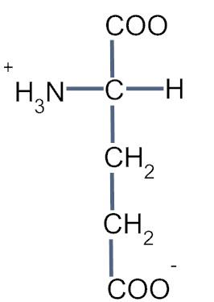
What might a transmembrane protein look like?
For 5 min- Pair & discuss:
Draw a lipid membrane
For a single protein that crosses the membrane:
What secondary/tertiary structures might be used?
For a protein complex that crosses the membrane:
What structures might be used?
If the side chain Phenylalanine (F)
were present, where might it be?
What about glutamic acid (E)?

Slide 23
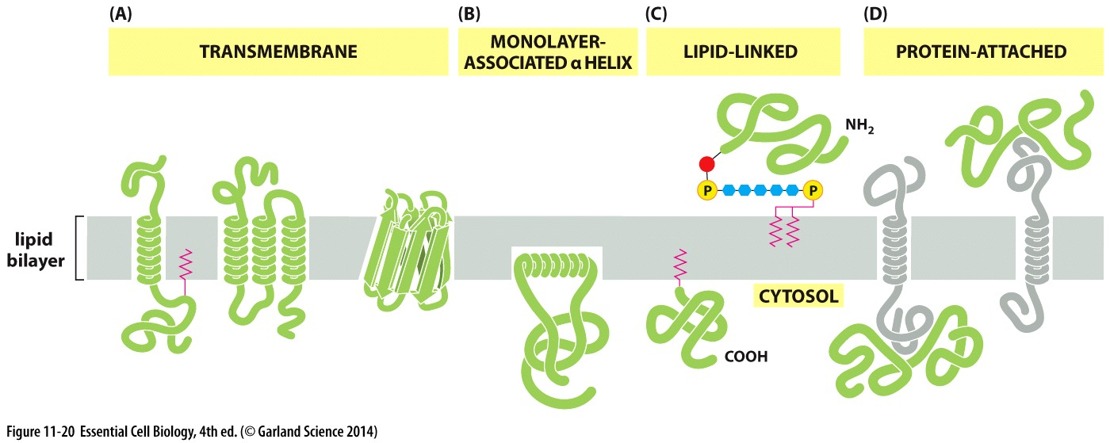
The many ways proteins associate with lipid bilayers..
Alpha helix and beta barrels are common secondary structures
Integral membrane proteins are not easily extracted from the lipid bilayer! → detergents to dissasemble membrane and solubilize proteins

Slide 24
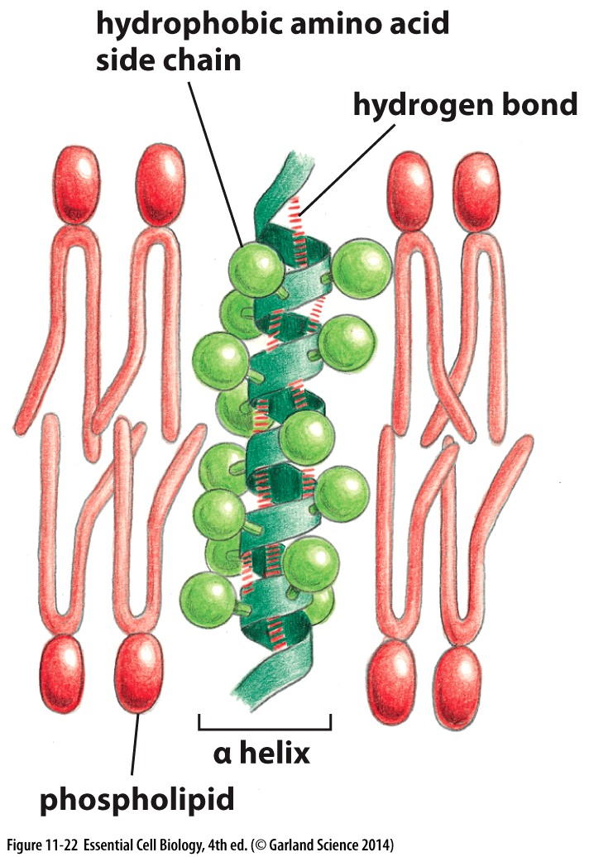
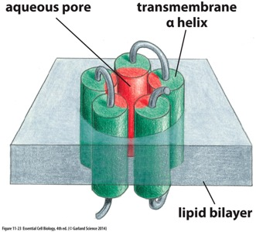
Exploit the hydrophobic lipid core to be stably associated
Hydrophobic side chains are not enough
hydrophilic peptide backbone needs to be shielded from hydrophobic environment

Slide 25
Regulating fluidity and protein composition

Slide 26
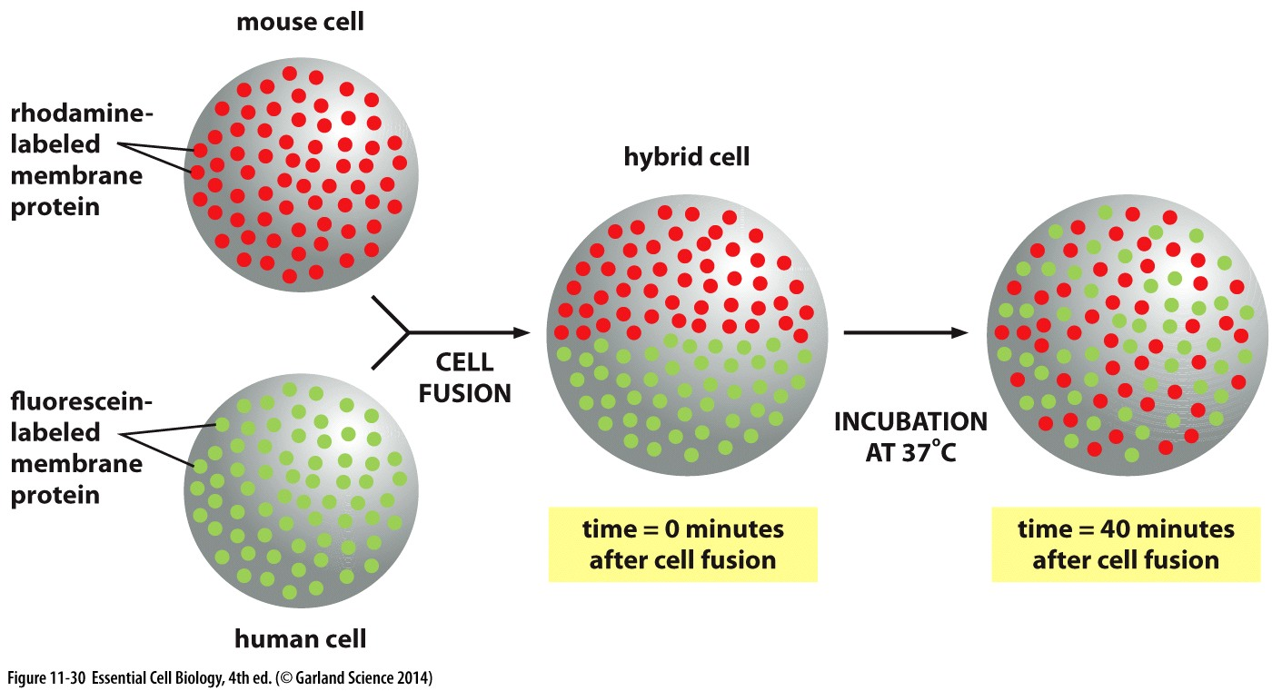
Fluidity of cell membranes is regulated
How do we know?
Without regulation membrane lipids and proteins would be evenly distributed
→some proteins do this, but not all

Slide 27
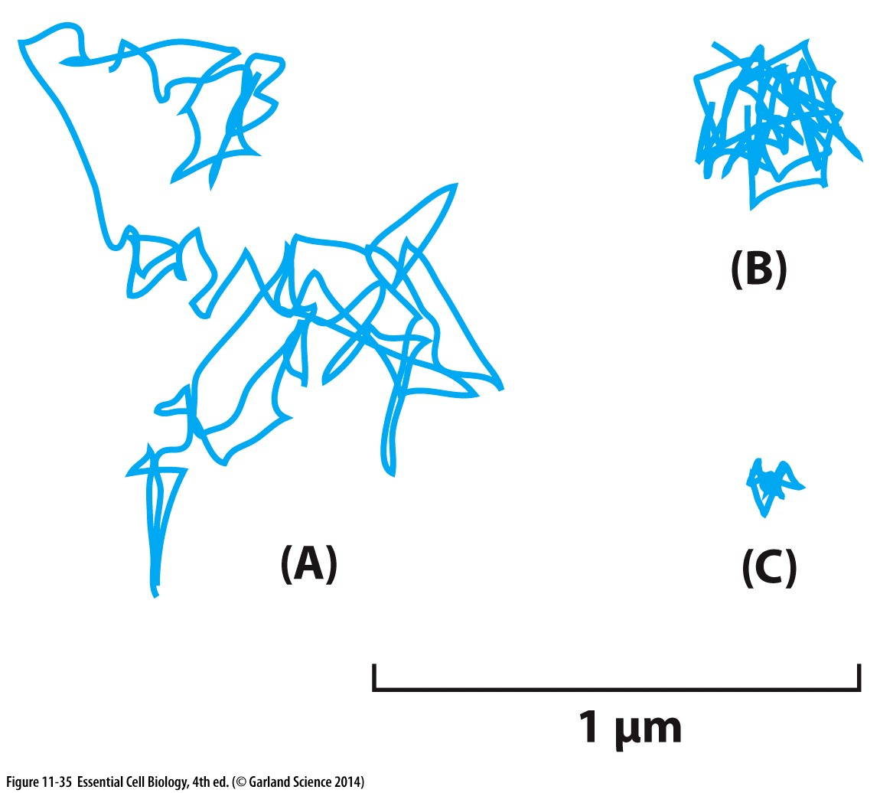
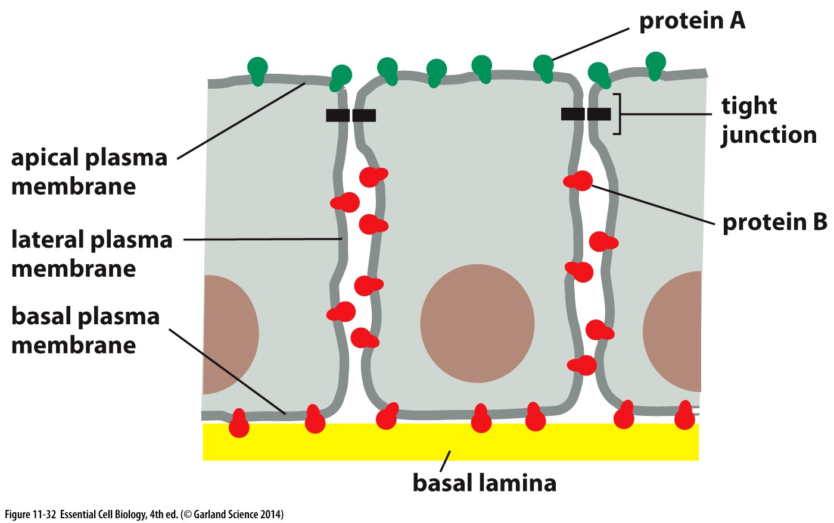
Fluidity of cell membranes is regulated
Tissue architecture relies on cells knowing
‘which way is up’
Fluidity:
Some membrane proteins show significant movement, some show none
promoting proper membrane protein placement → specific functions

Slide 28
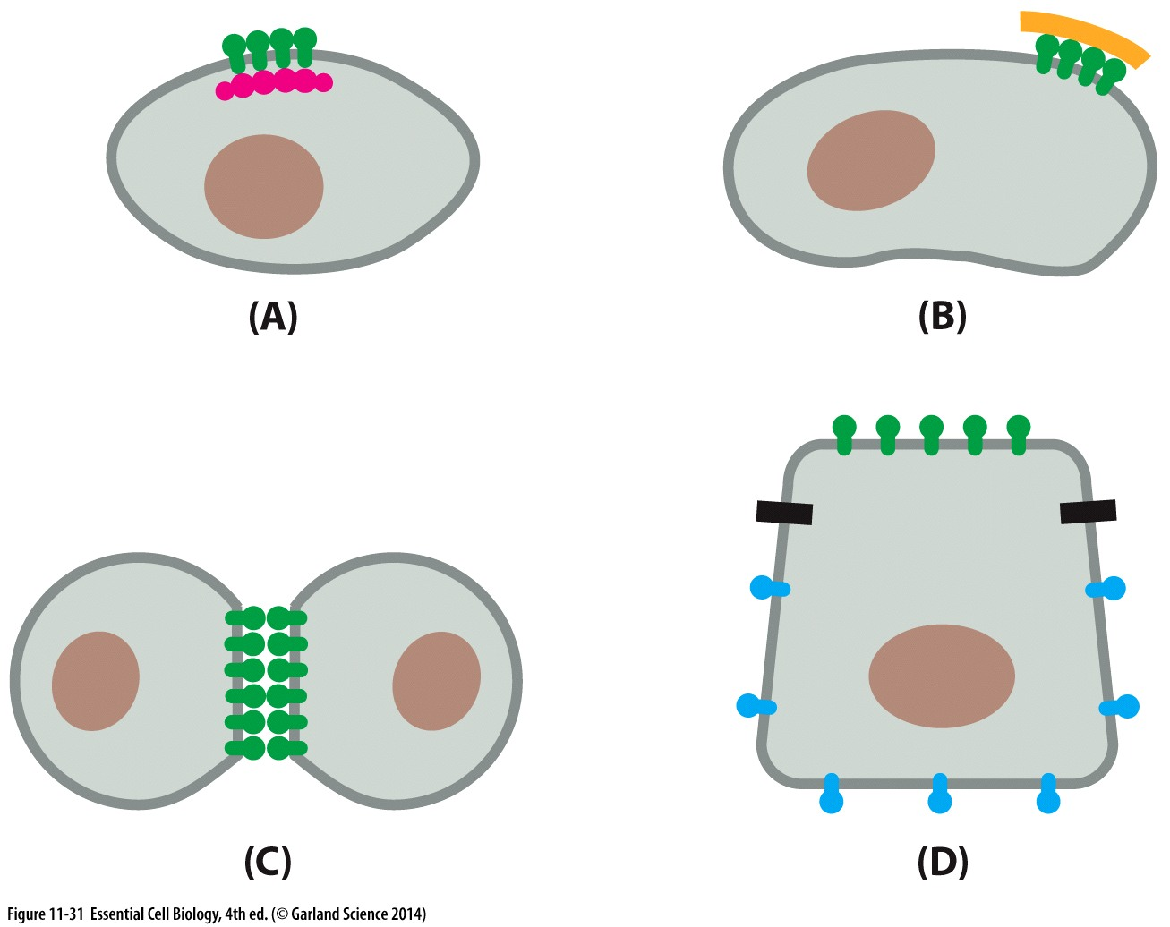
Membrane fluidity is constrained by protein-protein interactions
Membrane proteins can:
Bind stationary proteins with the cell
Bind stationary proteins outside the cell
Use external domains to interact with external domains of other membrane proteins
Be restricted by tight junctions/blocks set up by other membrane proteins

Slide 29
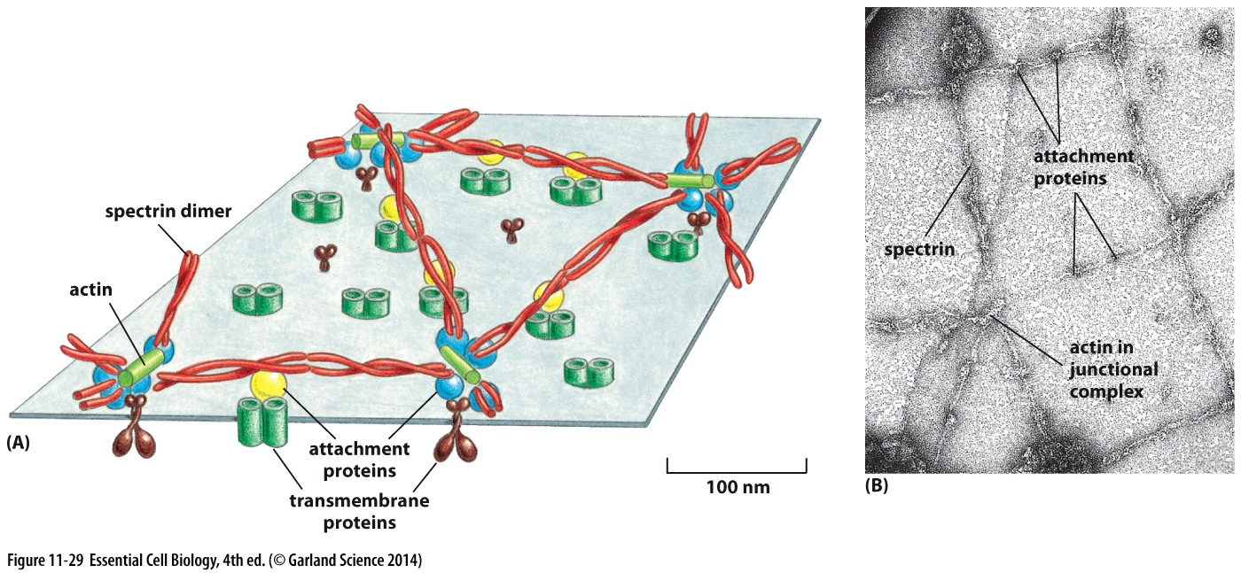
Cell cortex reinforces plasma membrane structure
Specialized cytoplasmic proteins on the inner surface of the cell membrane interact with actin cytoskeleton
components serve as anchors to restrict movement of membrane proteins

Slide 30
Chapter 12 Objectives
Understand the factors that influence transport of hydrophilic molecules across the membrane
Understand and be able to describe when active vs passive transport would occur
Be able to identify and describe types of active transport

Slide 31
Transport across cell membranes

Slide 32
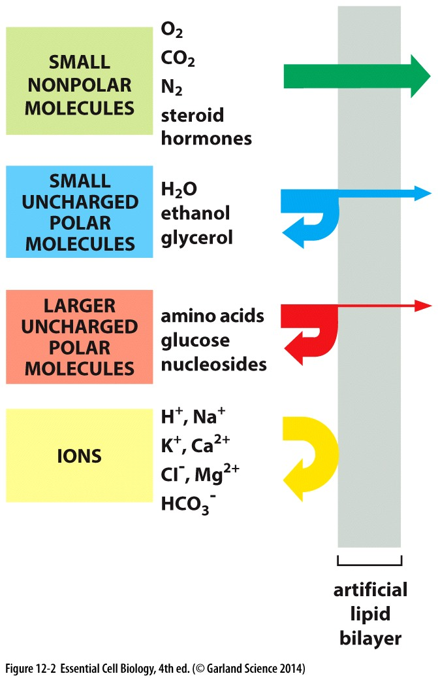
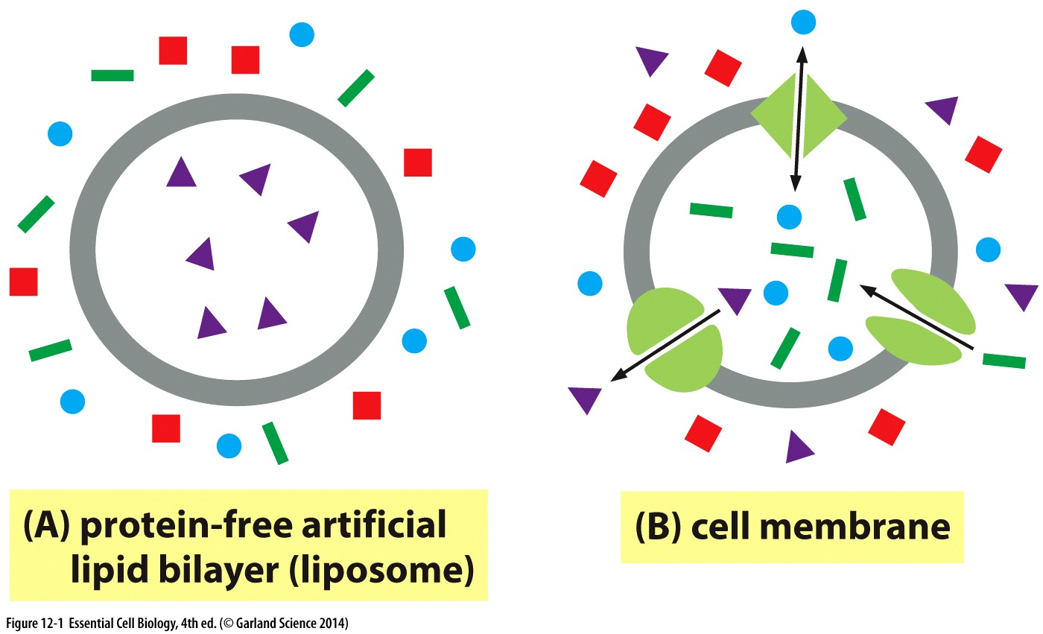
Membrane permeability
Smaller & less polar molecules diffuse faster
Artificial membranes are impermeable to water soluble molecules
Specialized proteins in the membrane facilitate the passage into and out of the cytosol

Slide 33
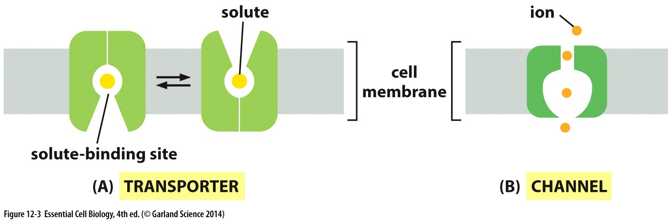
Transporters and channels
Both transporters and channels:
Allow transport of specific hydrophilic molecules
Transporter:
Conformational change to transfer molecules
Regulated by solute binding
Channel:
Open and closed conformation; fast transport when open
controlled by external stimulus

Slide 34
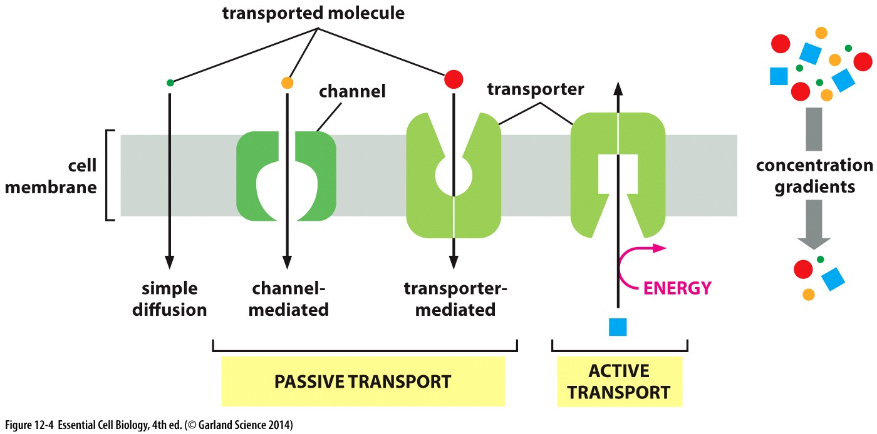
Passive vs active transport
Passive: With concentration gradient
Small non polar molecules diffuse (no channel or transporter)
Ions and small polar molecules use passive transport (both)
Active: against concentration gradient
Requires energy input: transporters only

Slide 35
Passive Transport
Channels and transporters
Direction of transport → not just concentration dependent!

Slide 36
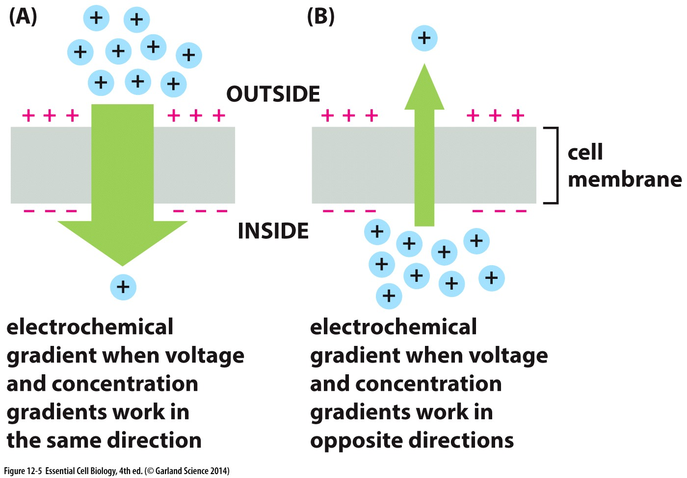
Considerations for charged molecules
Extracellular usually positive
Difference in charges on either side of a membrane → membrane potential
Membrane potential & Concentration gradient in the same direction = HIGH electrochemical gradient
Cytosolic side usually negative
Membrane potential exerts force on charged solutes
Passive transport
Uncharged molecules → concentration gradient only
Charged molecules → concentration & membrane potential = electrochemical gradient

Slide 37
Considerations for charged molecules
Extracellular usually positive
Membrane potential & Concentration gradient in opposite directions = LOW electrochemical gradient
Cytosolic side usually negative

Slide 38
Ion channels
Using specificity, charge & concentration to regulate composition of molecules on either side of the membrane

Slide 39
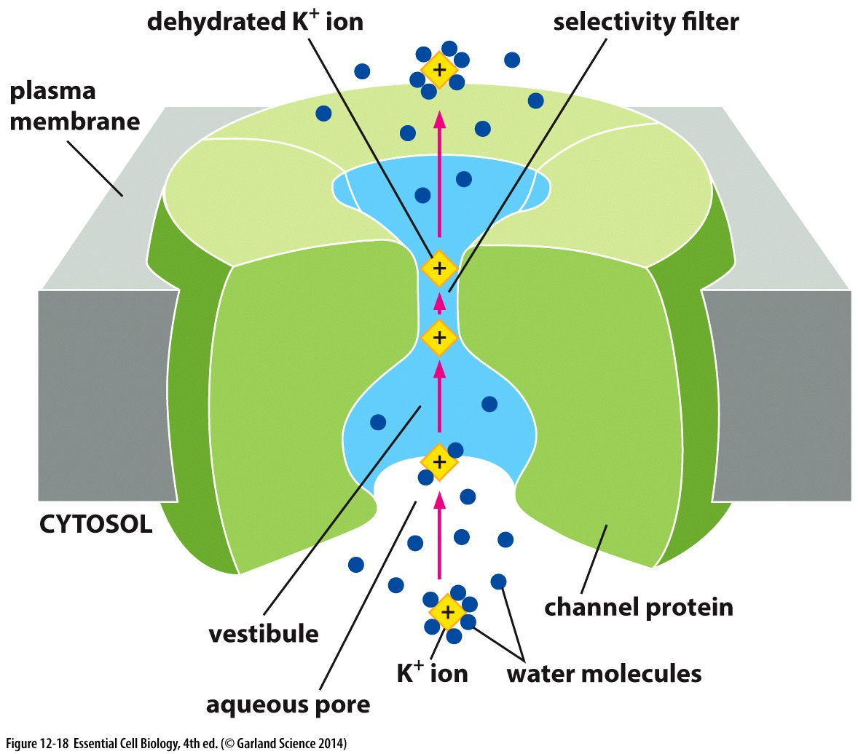
Ion channels: Passive transport
Not just membrane ‘holes’
Selective
Ion channel diameter, shape, & charge distribution
Ions pass single-file
Open briefly
Most are gated: switch to control open/closed configuration
Does not undergo conformational change with transport → transport is FAST

Slide 40
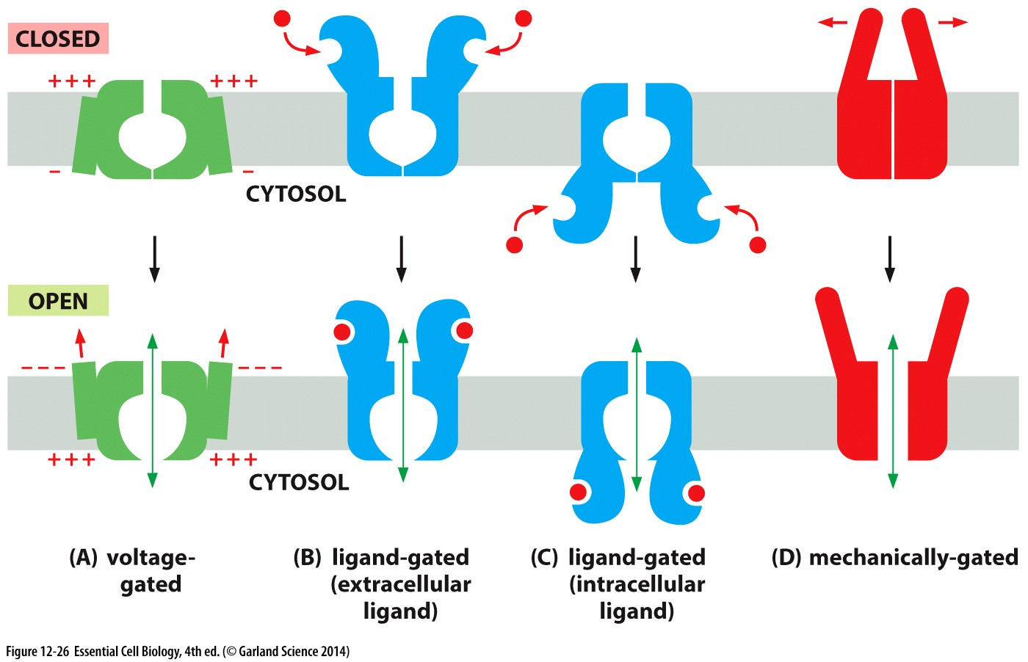
Gated channels
Gating regulates ion transport and enables
maintenance of gradients

Slide 41
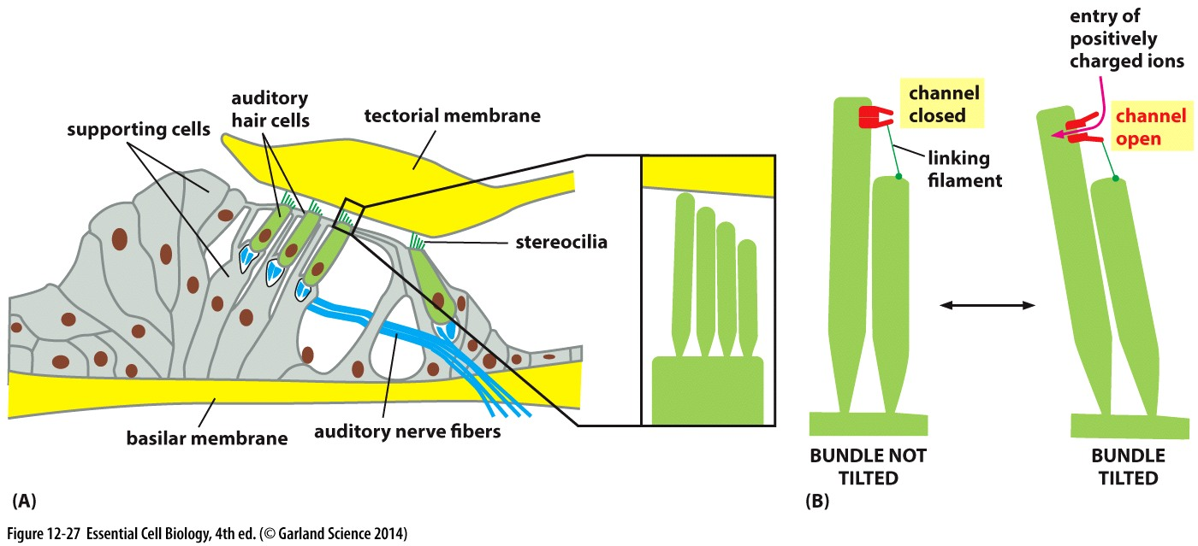
Example: Mechanically gated channels
In response to sound vibrations: open ion channels to allow positive ions in
Ion- activated hair cells stimulate nerve endings
Nerve fibers relay signal to the brain

Slide 42
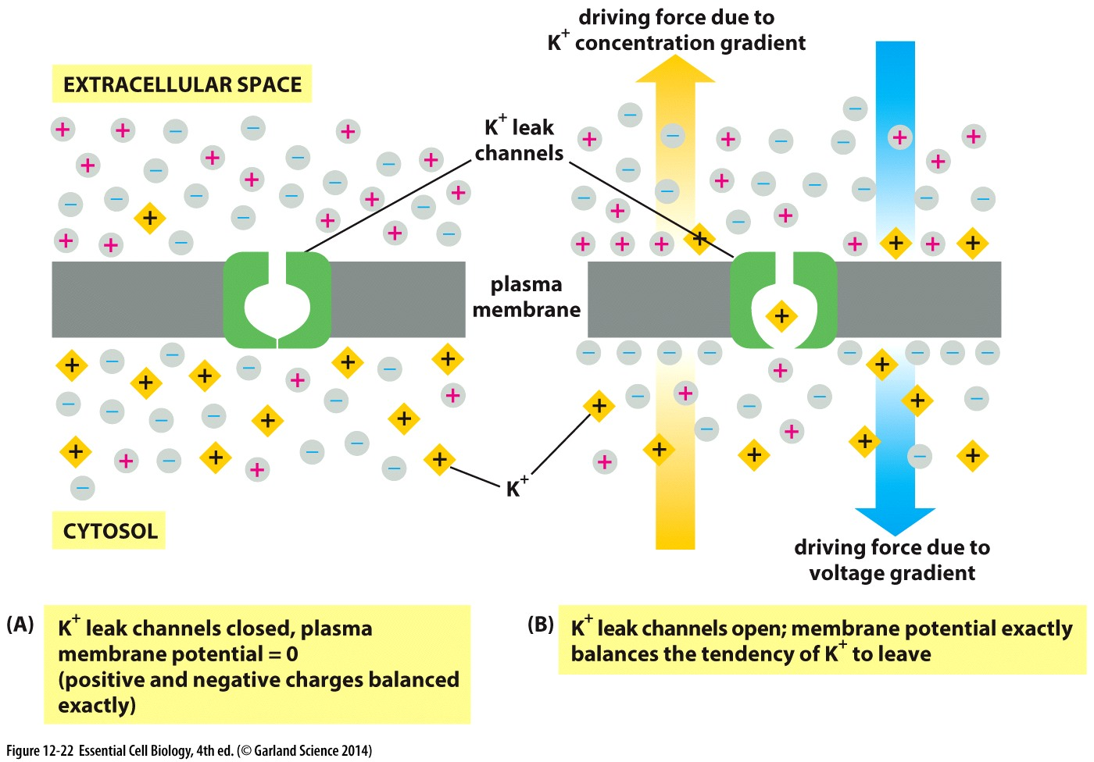
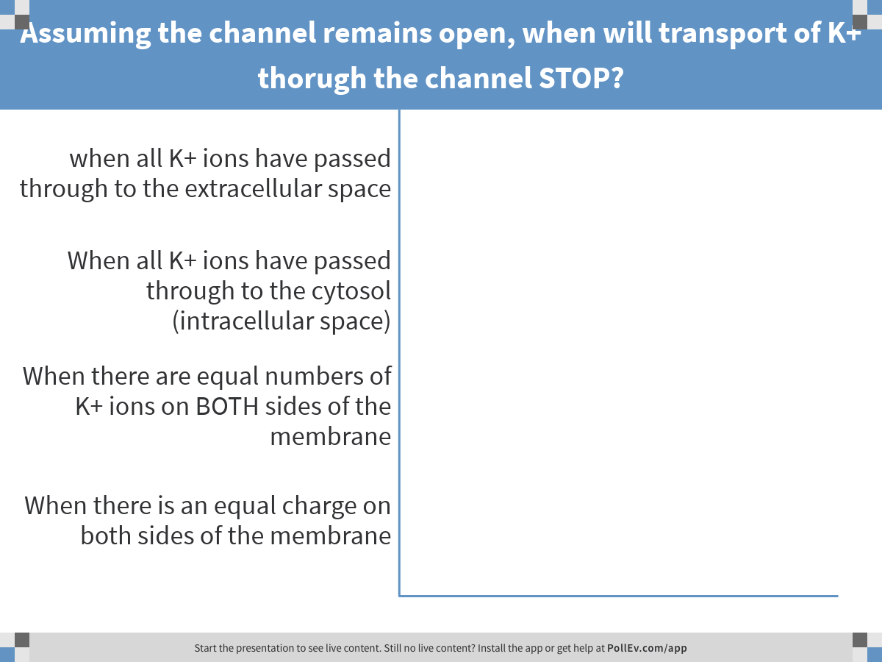
Notes:
Assuming the channel remains open, when will transport of K+ thorugh the channel STOP?
https://www.polleverywhere.com/multiple_choice_polls/QTnzV88RQklmggm

Slide 43
An open channel will allow it’s selective ion to pass until the concentration gradient = the voltage gradient

Slide 44
Transport of water
Water molecules are small and uncharged → diffuse…
…..but slowly

Slide 45
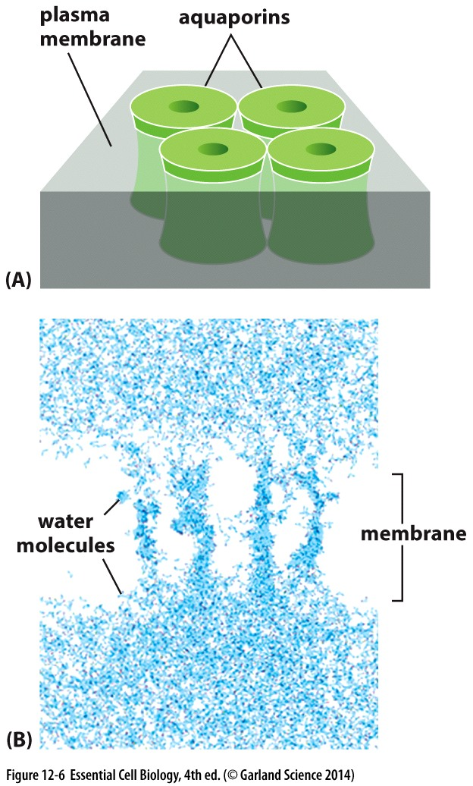
Transport of water
Water molecules are small and uncharged → diffuse…
…..but slowly
Aquaporins = protein channels that facilitate water transport across membranes
Water moves by osmosis:
Moves passively
down it’s concentration gradient
Cells have high concentration of solutes → water is pulled into the cell
Low osmolarity outside
High osmolarity inside
= high solutes

Slide 46
Transporters and their function

Slide 47
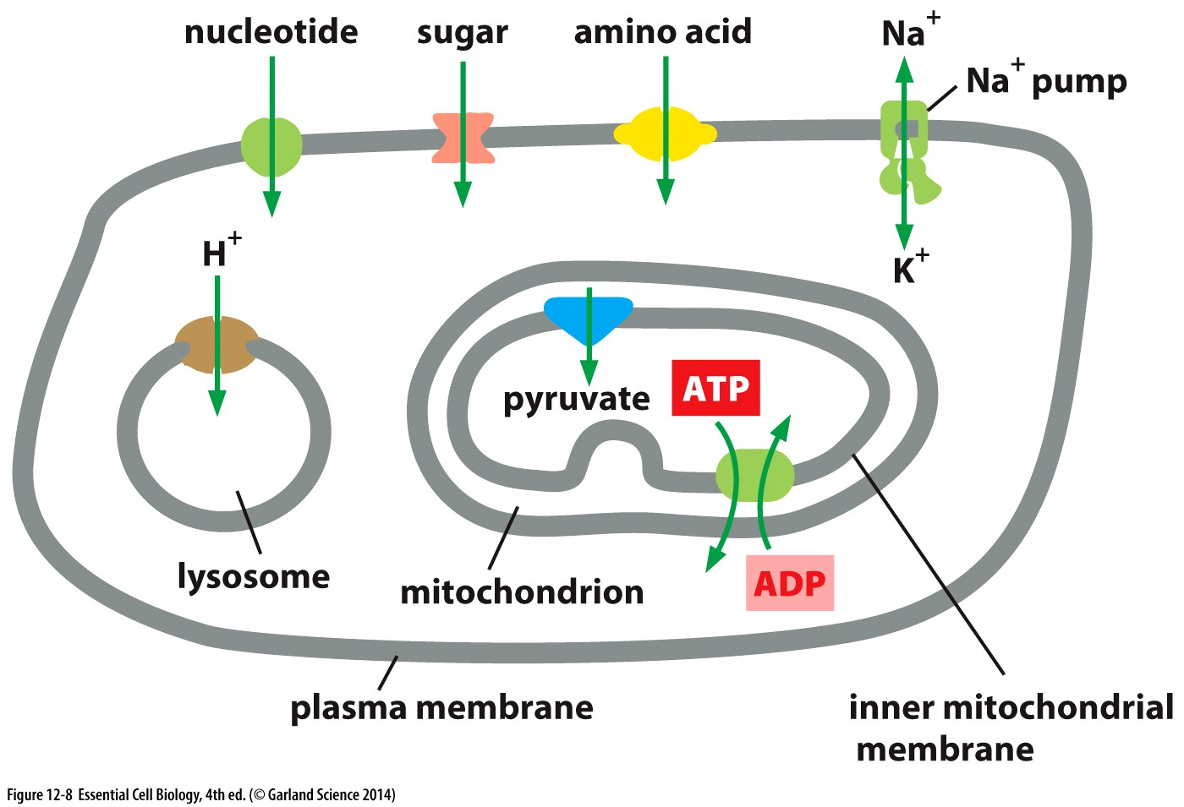
Transporters
Plasma membrane:
Nutrients and macromolecule subunits
Lysosome
Protons to acidify the interior
Mitochondria
Pyruvate/fuel
ATP
Each membrane has different transporters specific for it’s function

Slide 48
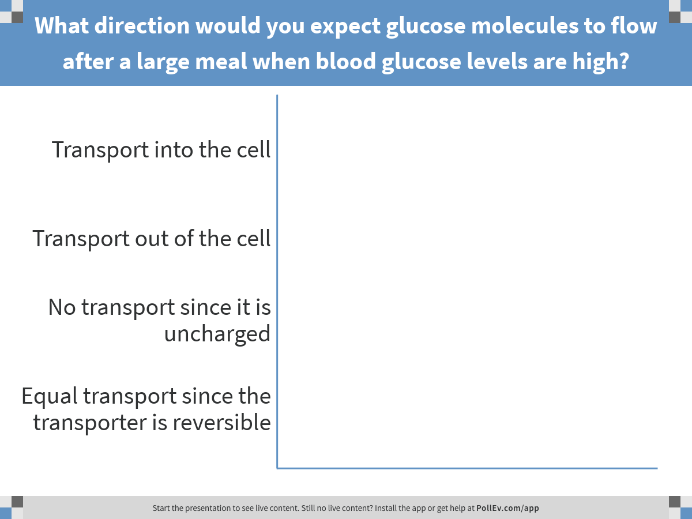
Glucose (sugar) molecules are large and uncharged
Notes:
What direction would you expect glucose molecules to flow after a large meal when blood glucose levels are high?
https://www.polleverywhere.com/multiple_choice_polls/WPa94QO8Kn8qILD

Slide 49
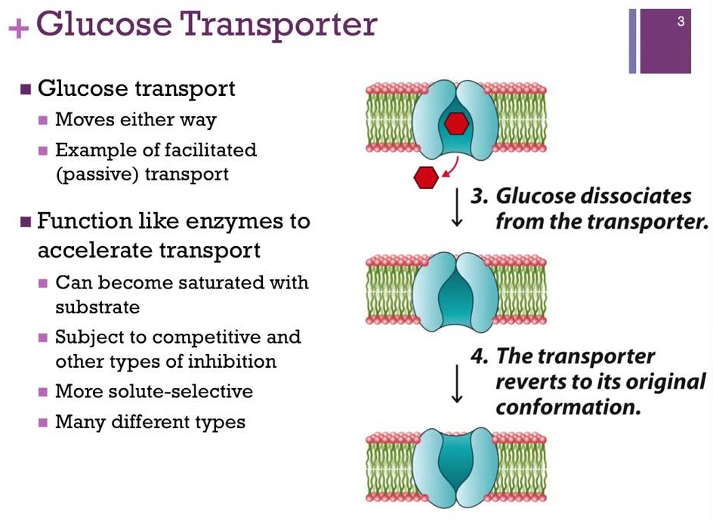
Passive Transporters
Transporter switches randomly and reversibly between conformations
Glucose binds the transporter

Slide 50
Passive Transporters
Transporter switches randomly and reversibly between conformations
Glucose binds the transporter
Passive transport considers concentration & chemical gradient (membrane potential):
Glucose is uncharged
Chemical gradient = 0
→ Moves with concentration gradient

Slide 51
Active transport
Achieving and maintaining distinct compositions on either side of the membrane

Slide 52
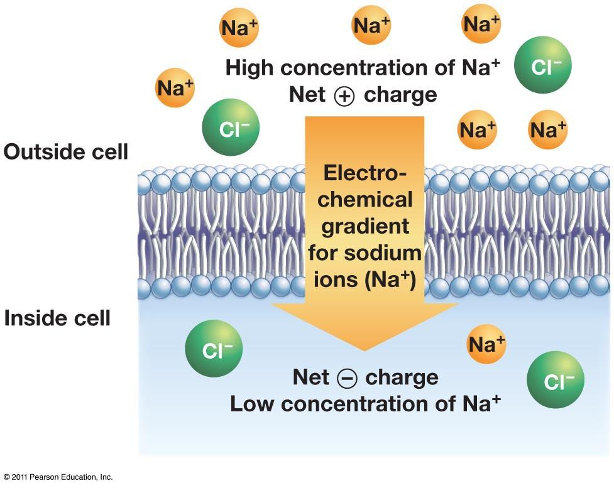
Passive Transport is not sufficient
Ion concentrations inside and outside a cell are different
Actively maintained
Passive transport:
Move solute along it’s electrochemical gradient
How to get solutes from:
a low concentration to high concentration?
Towards a like-charged membrane potential?
Active Transport!

Slide 53
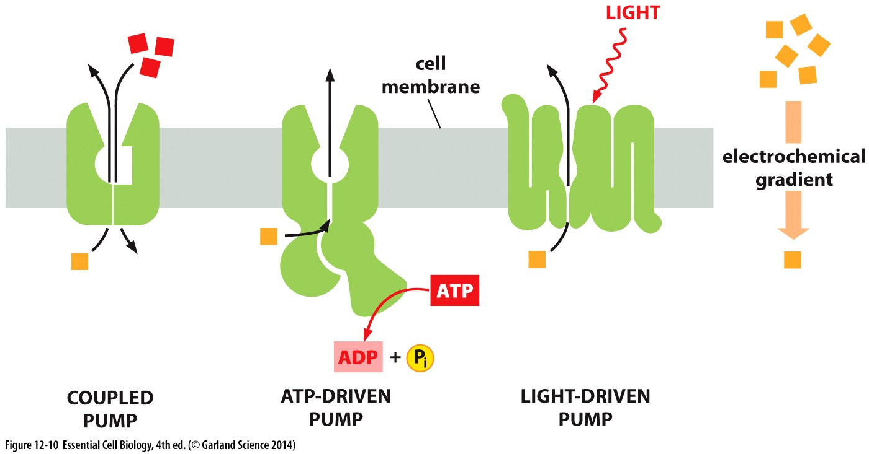
Pumps transport against electrochemical gradient
3 types of pumps:
ATP-driven pumps: energy from ATP hydrolysis
Coupled pumps: link to favorable/passive transport
Light-driven pumps: bacteria

Slide 54
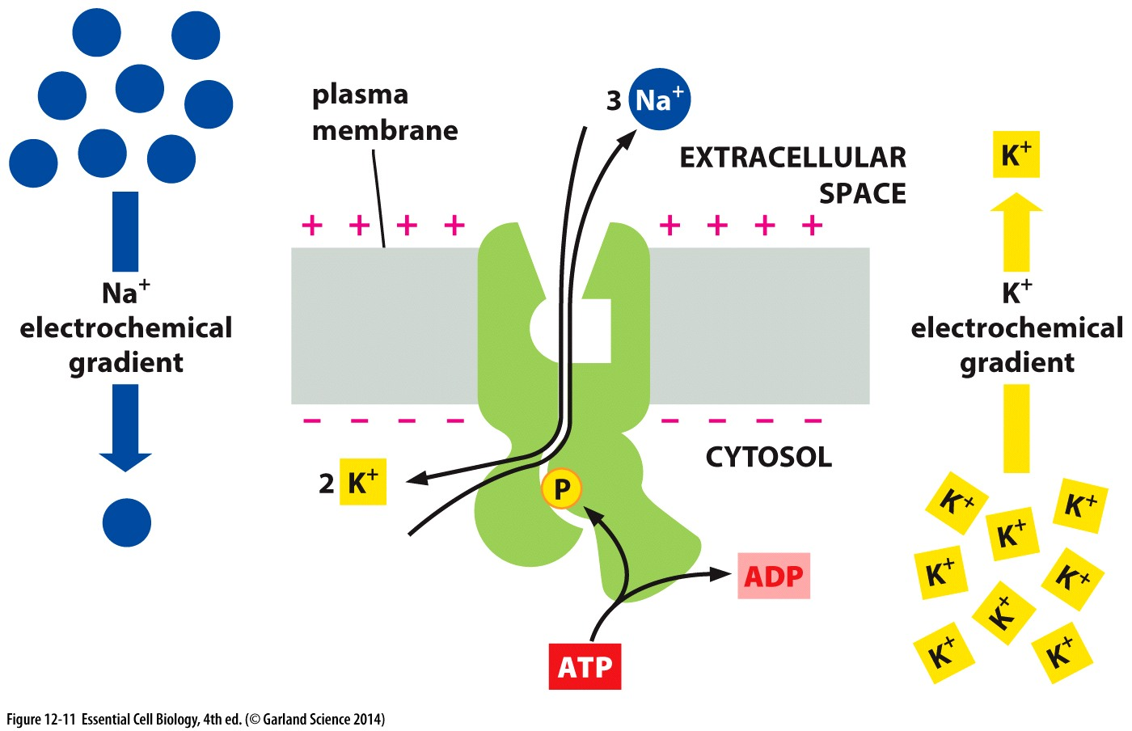
Achieving steep gradients
Cells maintain cytosolic vs extracellular:
Na+ 10-fold lower
K+ 30-fold higher
Use energy from ATP hydrolysis to drive transport against electrochemical gradient

Slide 55
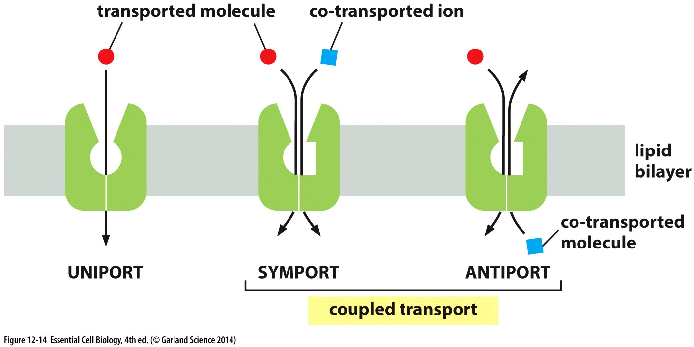
Coupled pumps
Can be either passive or active transport (or both)
Exploit solute gradients to drive unfavorable transport

Slide 56
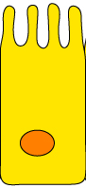
Plasma membrane composition is not uniform
Gut lumen:
Low glucose & High Na+
Different channels or transporters on different surfaces
Sugars we consume must be absorbed (taken up) from the gut lumen, into the cell, then passed into the blood stream (extracellular space)
What role might Na+ transporter play in the transport of glucose from the gut to the extracellular space?
Intracellular:
High glucose
Extracellular:
Low glucose & Low Na+

Slide 57
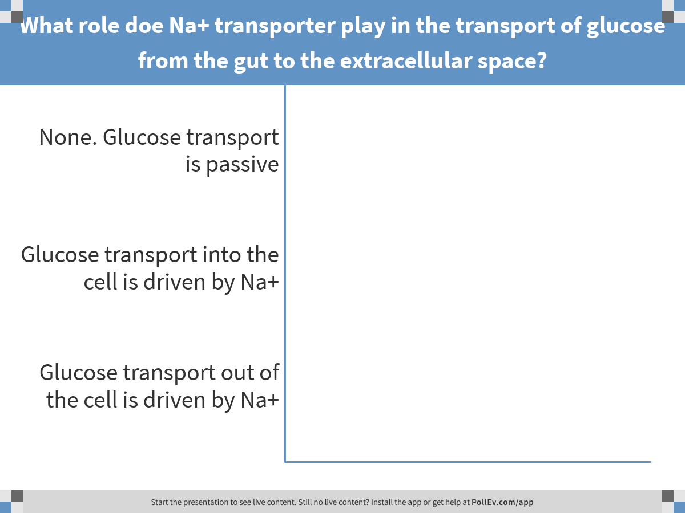
Gut lumen:
Low glucose & High Na+
Intracellular:
High glucose
Extracellular:
Low glucose & Low Na+
Notes:
What role doe Na+ transporter play in the transport of glucose from the gut to the extracellular space?
https://www.polleverywhere.com/multiple_choice_polls/dmBCAYmBRJbp7Wp

Slide 58
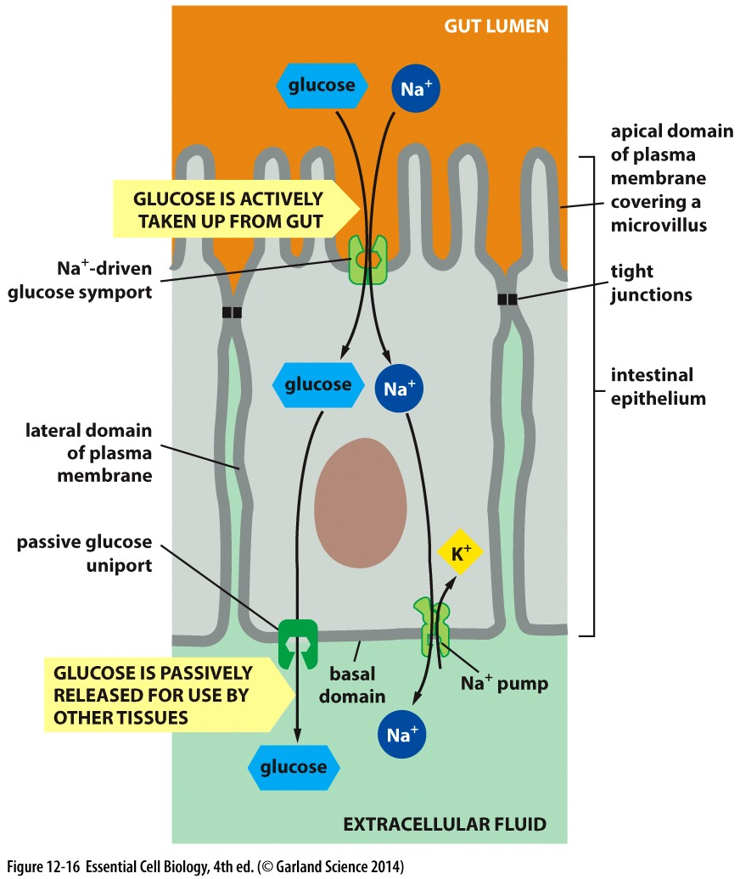
Membrane composition is not uniform
The apical surface of a gut cell sees a different environment then the basal surface
Lumen → cytosolic = active transport with a Na+ symporter
Cytosolic → extracellular = passive for glucose;
active (K+ antiporter) for Na+

Slide 59
Passive vs active transport
A summary

Slide 60
Transport across the membrane
PASSIVE
active
Diffusion
Small, nonpolar, uncharged molecules
Channels
Gated!
Example: ion channel
Transporters
Solute binding→ conformational change

Slide 61
Transport across the membrane
ACTIVE
Transporters
Requires energy INPUT from:
Favorable transport (down electrochemical gradient)
ATP
Light
= pumps

Slide 62
Transport across the membrane
PASSIVE
ACTIVE
Channels
Transporters
Transporters = pumps
Have Selectivity & Specificity

Slide 63
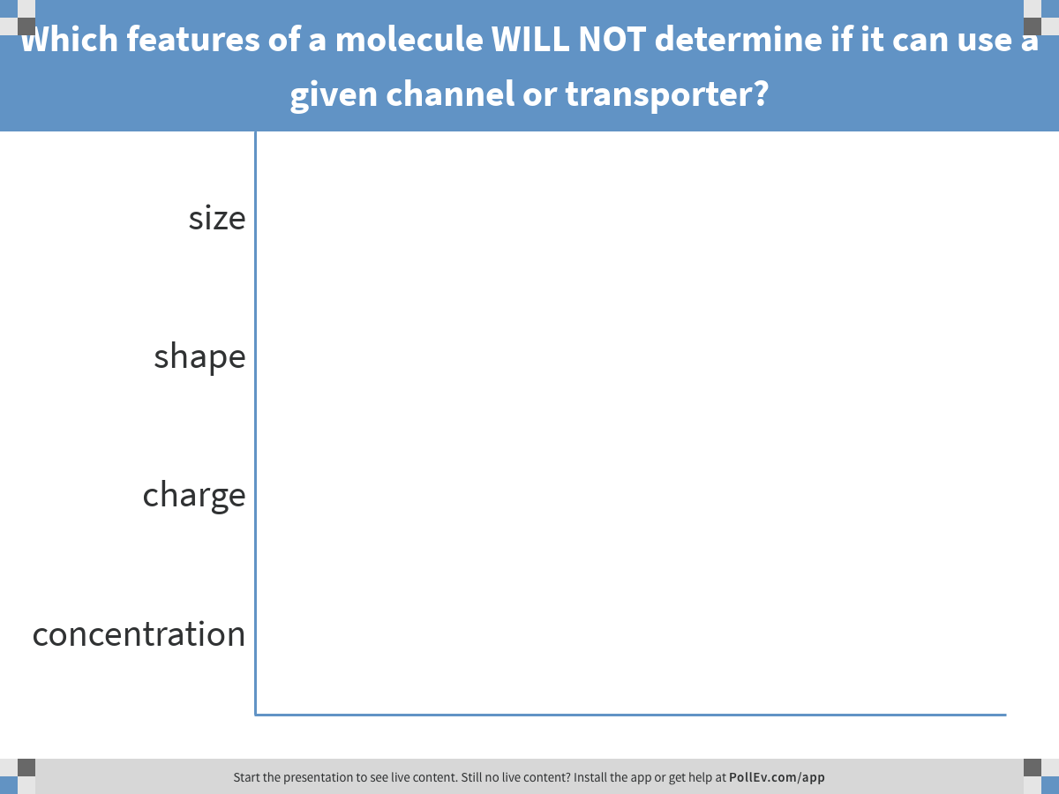
To maintain defined composition within cells or organelles, pumps and transporters must facilitate the transport of SPECIFIC molecules
Notes:
Which features of a molecule WILL NOT determine if it can use a given channel or transporter?
https://www.polleverywhere.com/multiple_choice_polls/MFDY2UEgMov0jMV

Slide 64
Selectivity
Channels: Not just membrane ‘holes’
Ion channel diameter, shape, & charge distribution
Ions pass single-file
Transporters:
Solute binding site requires specific size/charge (non-covalent interactions)

Slide 65

Pumps Drive Active Transport
Pumps can be driven by:
Light energy
ATP energy

Slide 66

Pumps drive active transport
Notes:
Which if the following would NEVER require a pump to pass across the membrane
https://www.polleverywhere.com/multiple_choice_polls/JdGbqykcI8q9vnZ

Slide 67
Passive transport MUST be energetically favorable

Slide 68
Does this mean a channel can NEVER be used to move an ion AGAINST it’s gradient?
NO!
Ions can passively pass through an open channel until:
concentration gradient = voltage gradient
Example:
more neg- charged ions INSIDE the membrane or other pos+ charged ions OUTSIDE the membrane would promote movement of K+ through the channel

Slide 69
Putting it all together: a mini workshop
The apical (top) and basal (bottom) surfaces of a cell have distinct functions and are exposed to distinct environments outside the cell.
Imagine a cell whose function is to transmit a molecular signal from the extracellular space above to receptors on the cell below. How might this look?
Consider, discuss, and draw:
What does the lipid bilayer look like?
Think about membrane fluidity and regulation.
The inside of the membrane has distinct needs and functions from the outside of the membrane For example, the actin cytoskeleton interacts with the inner lipid layer, while signaling molecules interact with the outer lipid later. How Is the identity of the inner and outer lipid bilayers regulated?
Import into the cell and export out of the cell happen at distinct regions of the membrane. How are distinct regions defined and maintained within the membrane?
Think about how proteins interact with membranes.
What features of a channel or transporter protein might enable it to BOTH integrate in a membrane AND interact with the molecule it will move across the membrane?
Think about how transport across membranes is regulated.
What might impact if the molecule will move across the membrane?
Assume that conditions are unfavorable for PASSIVE transport- provide an example of how the cell might enable the molecule to gain entrance to the cell anyway.

